Slide 1
Diyala University
College of Engineering
Department of Civil Engineering
Water Resources Engineering
for 4th Class
By
Dr. Saad Shauket Sammen

Slide 2
4-Runoff (R)
Runoff is that portion of precipitation that is not evaporated. When moisture falls to the earth’s surface as precipitation, a part of it is evaporated from the water surface, soil and vegetation and through transpiration by plant, another part of precipitation seeps into the soil as infiltration, and the remainder precipitation is available as runoff which ultimately runs to the ocean through surface and subsurface streams. Thus runoff may be classified as follows:
Surface flow (runoff): Water flows over the land to reach the streams and rivers, which ultimately discharge the water to the sea.
ii) Subsurface flow (runoff): A portion of precipitation infiltrates into surface soil and depending upon the geology of the basins runs as subsurface flow and reaches the streams and rivers.

Slide 3
4.1 Hydrograph Analysis
Hydrograph is a graph showing changes in water discharge over a period of time for a given point on a channel or conduit, is commonly used in many engineering applications. For example, hydrologists depend on hydrographs to provide peak flow rates so that hydraulic structures can be designed to accommodate the flow safely. In addition, the area under the curve of a hydrograph can provide the volume of water, which allows analysis of reservoir sizes, storage tanks, detention ponds, and other facilities that deal with volumes of runoff passing the point of interest during a time.
The shape of the hydrograph changes according to the properties of the basin and meteorological conditions such as rainfall pattern, hydrologic losses, groundwater flow, and surface characteristics including size, roughness, shape, slope and imperviousness.

Slide 4
A specific hydrograph can be estimated by following two main steps. Initially, continuous records of water flow versus depth are taken at the channel location. In small channels, these records are estimated by using a device such as a weir. In large channels, placing a flow measuring device in the channel becomes practically difficult, and instead flow rates are measured by using a current meter. Then, a rating curve is plotted, which is a relation between flow rate and stage.Indirect methods to estimate the water discharge for a given depth is accomplished by employing open channel flow equations such as that of Manning or Chezy. Next, the relation between flow rate and depth is used to transform continuous records of stage versus time into a hydrograph.
A typical storm hydrograph is shown in Figure (1.8) with the following various parts

Slide 5
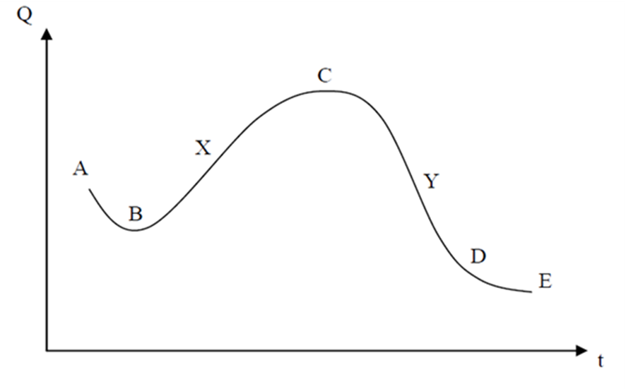
Fig. 8 Storm hydrograph
ABXCYDE: total hydrograph
AB: baseflow before the storm (groundwater)
BXCYD: storm hydrograph (or direct runoff hydrograph)
BXC: rising limb (concentration curve)
CYD: falling limb (recession curve)
XCY: peak segment
DE: baseflow after the storm (groundwater)
C: peak discharge

Slide 6
A common practice is to consider the hydrograph divided into two parts of baseflow and direct surface runoff hydrograph. Baseflow indicates the groundwater contribution, and direct runoff indicates the runoff caused by excess rainfall. The simplest method for the separation of baseflow and direct runoff is by drawing a straight line from B to D. The portion of the hydrograph below BD is considered to be baseflow, and that above BD is the direct runoff.

Slide 7
4.2 Unit Hydrograph
A unit hydrograph is the hydrograph of direct water surface runoff that results from a total depth of one unit of excess rainfall (e.g., 1 in, 1 mm, etc.) uniformly distributed over the basin and occurring within a specified duration of time. The unit hydrograph theory is based on several assumptions. The storm used in deriving the unit hydrograph should be restricted to constant rainfall intensity within the time duration, implying a short duration storm event. The time of concentration for the basin is considered to remain constant for any rainfall intensity and duration. The rainfall intensity should also have uniform spatial distribution over the watershed area, implying that the watershed is not too large. If the watershed area is too large, then it can be divided into subareas of which each has to be analyzed separately. The total duration of a unit hydrograph, referred as the base time, depends only on rainfall duration, not the excess rainfall intensity. Here, the unit hydrograph notation to be used is UHd, where “d” denotes the rainfall duration.

